Slide 1
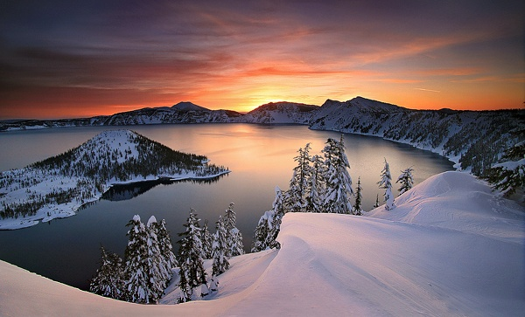
Crater Lake
Notes:
Although much lower in elevation than Mt. Rainier, Crater Lake is perhaps the most beautiful of the Cascadian volcanoes.

Slide 2
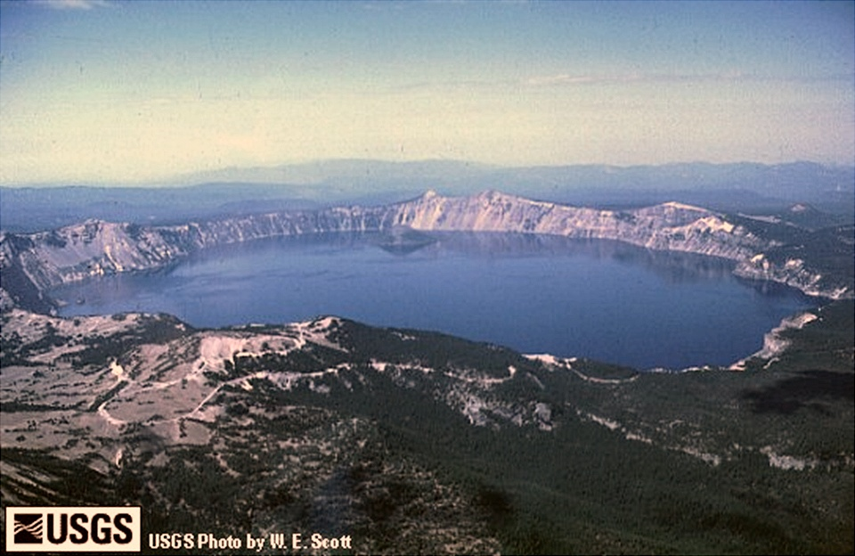
Notes:
This magnificent lake is misnamed, however, because it fills a caldera - not a crater. Calderas are formed by volcanoes either blowing their tops clean off, or more commonly, and as is the case here, by collapsing into their own magma chambers after unusually large eruptions.

Slide 3
Deepest point = 1,949’
Notes:
The collapse formed a tremendous depression which later filled with rain water to become one of the deepest lakes in the world. In fact Crater Lake has the greatest average depth of any lake in the world whose basin lies entirely above sea level. Much more important than this interesting bit of trivia, is that the volcano’s collapse exposed in the caldera’s rim, an exceptionally complete record of the growth and demise of a major composite volcano.

Slide 4
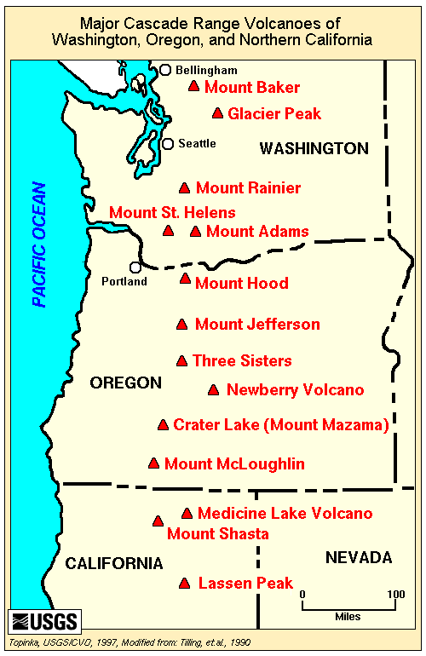
Notes:
The original volcano that collapsed to form Crater Lake is named Mount Mazama…

Slide 5
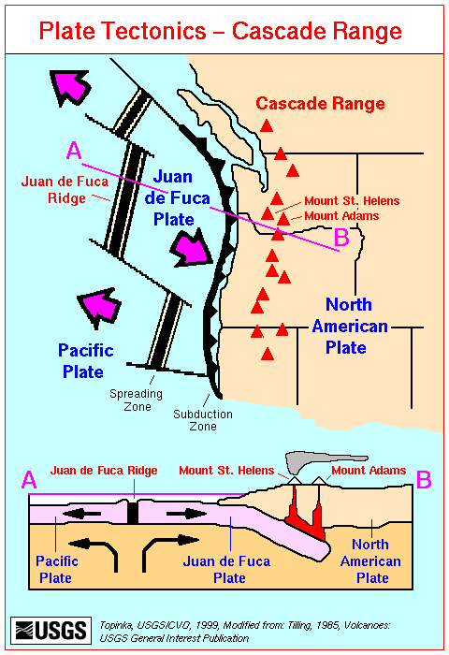
Notes:
… and like all Cascadian volcanoes, Mount Mazama formed from magma generated by the subduction of the Juan de Fuca Plate under the North American Plate.

Slide 6
Crater Lake History
Built on older shield volcano
Growth of Mt. Mazama composite volcano
Glacial erosion (concurrent with volcanism)
Explosion craters fill with domes
Massive eruption of Mt. Mazama and subsequent caldera formation
Resurgent volcanism in caldera
Notes:
However the history of the Crater Lake volcano began differently than other Cascadian volcanoes. Mt. Mazama was formed on top of an older shield volcano.

Slide 7
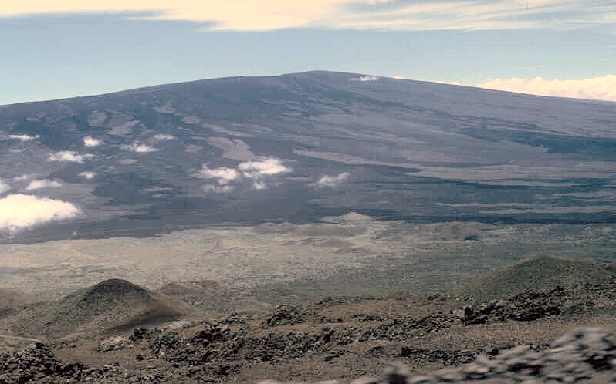
Shield Volcano
Notes:
Shield volcanoes are built almost entirely of basaltic lava flows. The highly fluid basaltic lava gives shield volcanoes much gentler slopes than the composite volcanoes which are typical of volcanic arcs.

Slide 8
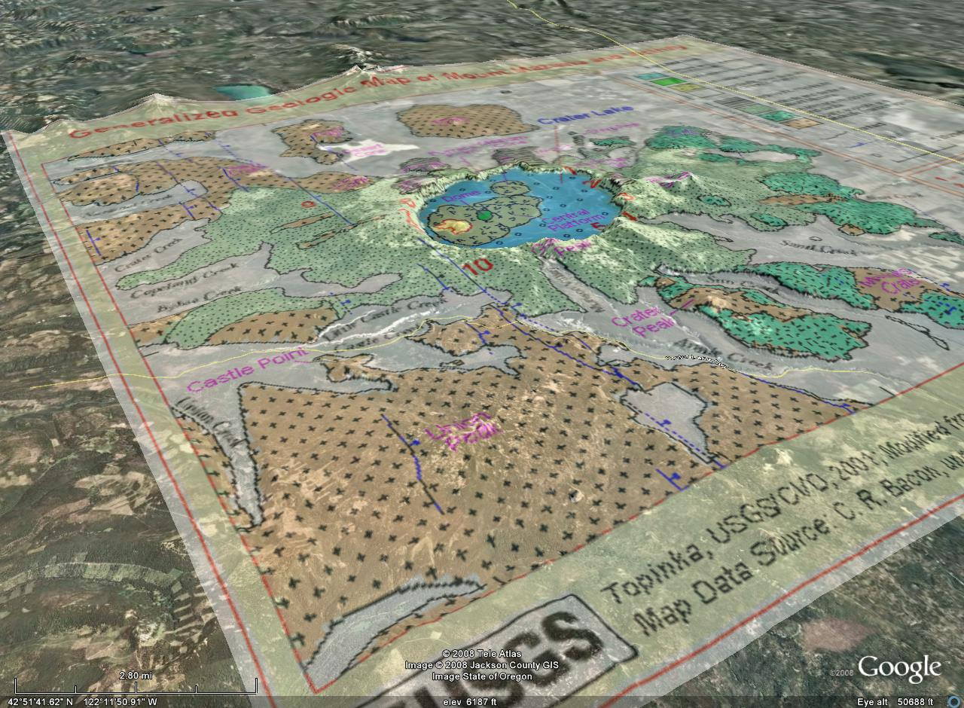
Basaltic andesite flows
Notes:
Remnants of the old shield volcano outcrop in many areas around Crater Lake as basaltic andesite flows. But why did a shield volcano form in a volcanic arc, which is a tectonic setting that generally builds composite volcanoes?

Slide 9
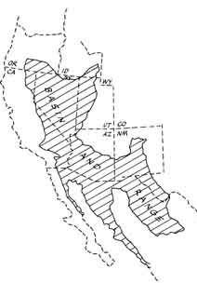
Notes:
You probably thought you had seen the last of this diagram.

Slide 10
Crater Lake
Notes:
But notice that Crater Lake sits on the northwestern edge of the Basin and Range!

Slide 11
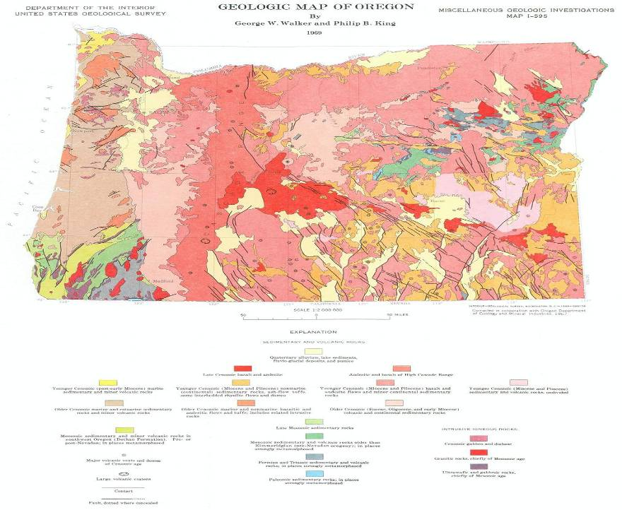
Basin and Range Structure
Crater Lake
Notes:
You can see the Basin and Range structure in this geologic map and Oregon. Of course you remember what kind of volcanism is common in the Basin and Range right?

Slide 12
Crater Lake
Bimodal volcanism
Notes:
That’s right – bimodal volcanism, and the original magma produced by the decompression melting which takes place beneath this area of stretching and thinning, is basalt. Basaltic magma is hot enough to partially melt continental crust. It can also differentiate into intermediate and felsic magma. Either process could explain the general trend seen in the area towards more silica rich volcanism through time.

Slide 13
Crater Lake History
Built on older shield volcano
Growth of Mt. Mazama composite volcano
Glacial erosion (concurrent with volcanism)
Explosion craters fill with domes
Massive eruption of Mt. Mazama and subsequent caldera formation
Resurgent volcanism in caldera
Notes:
Intermediate composition magma began to erupt in the area about 420,000 years ago forming a complex of composite volcanoes …

Slide 14
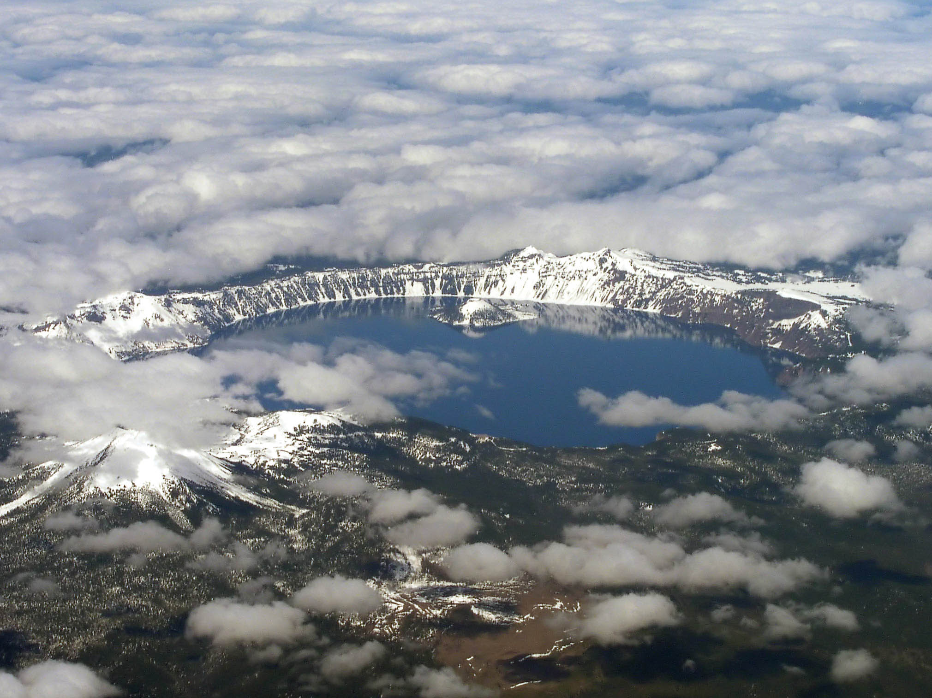
Garfield Peak
Applegate Peak
Mount Scott
Notes:
… starting at Mount Scott, and working westward towards Applegate and Garfield Peaks. These peaks are but a few of the many smaller composite volcanoes which collectively formed the massive Mount Mazama.

Slide 15
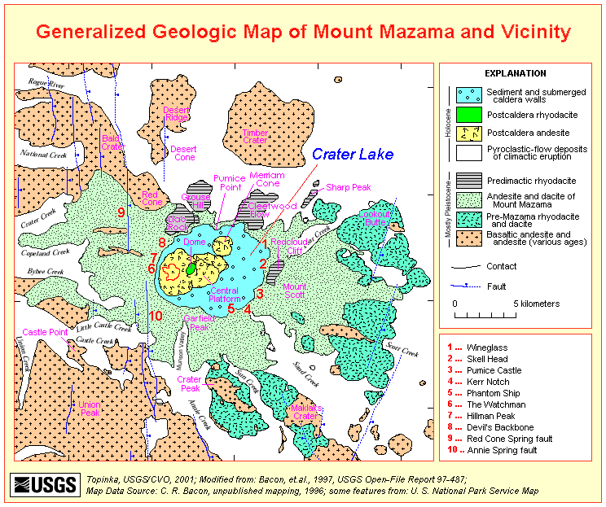
Andesite and Dacite
Notes:
The bulk of Mount Mazama was made up andesite and dacite flows erupted from multiple vents.

Slide 16
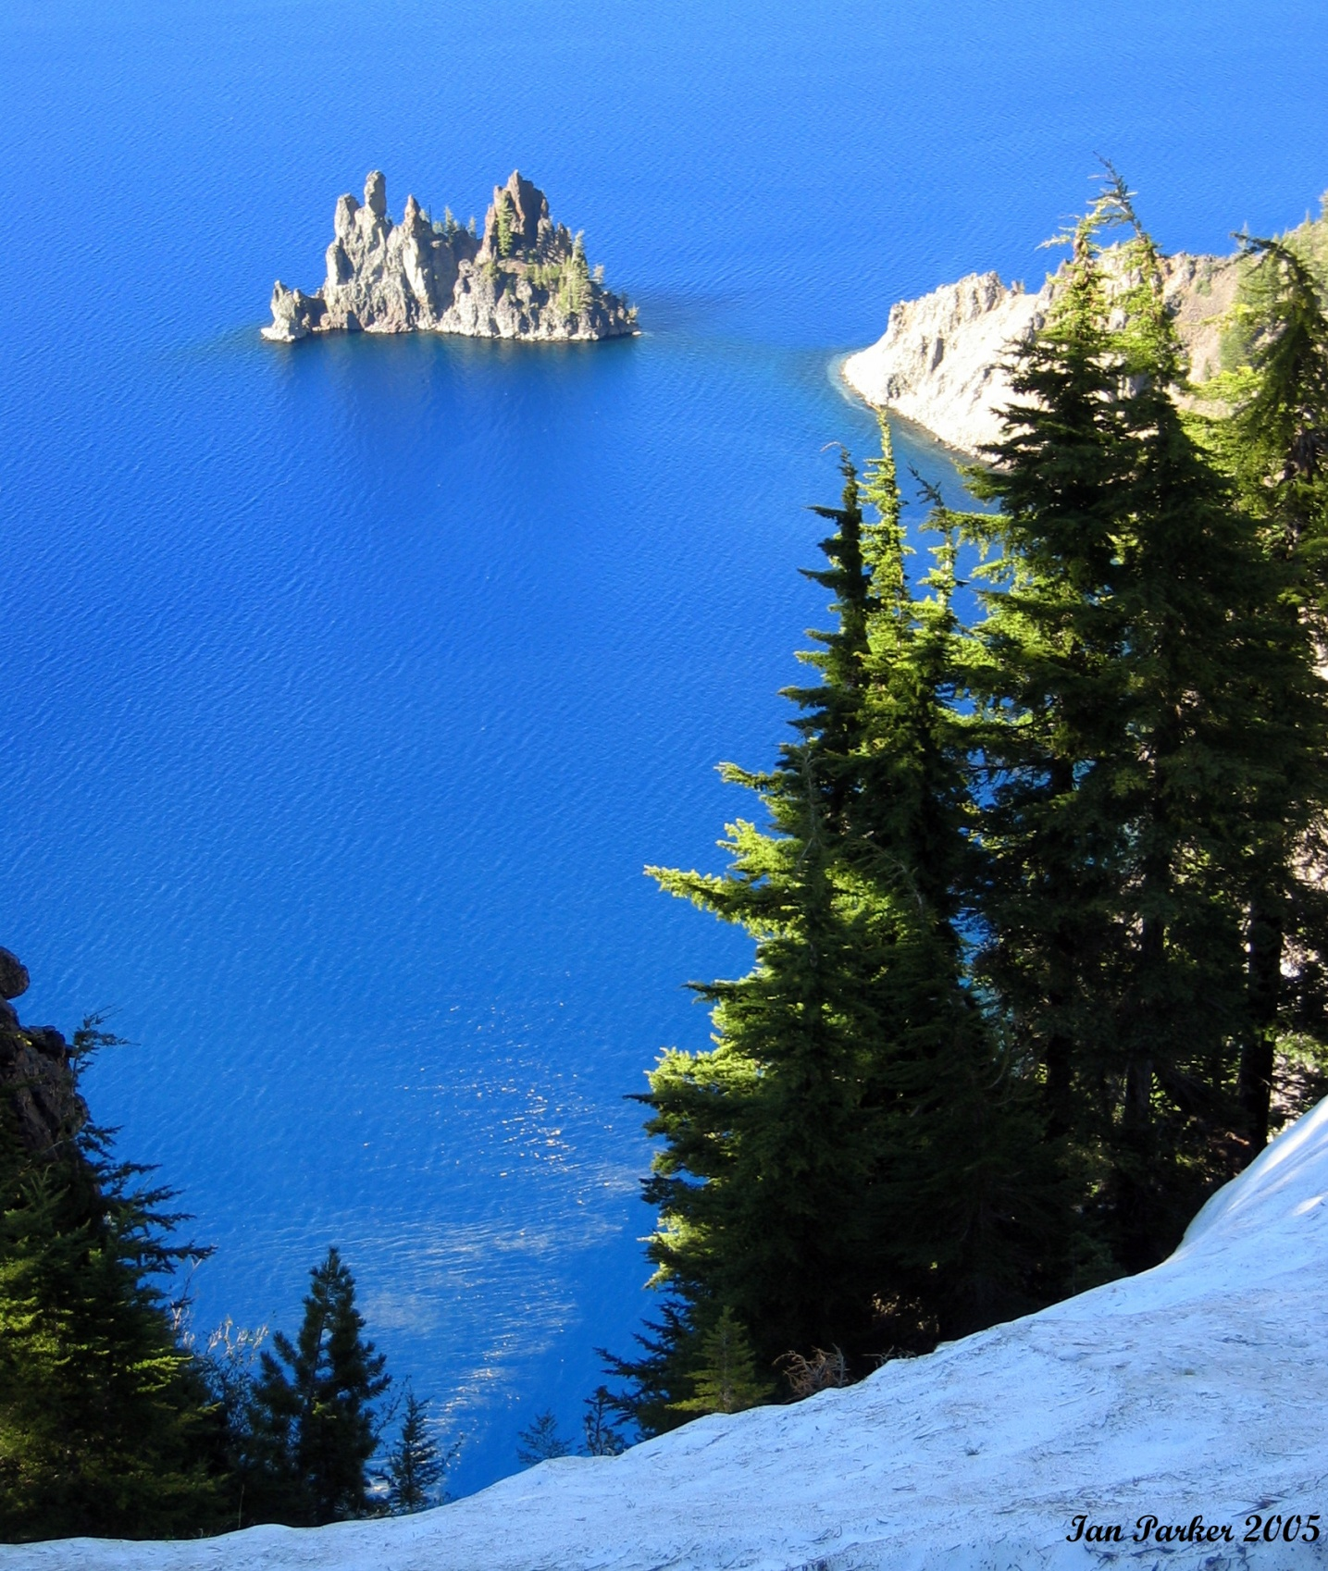
Phantom Ship
Notes:
At 400,000 years old, Phantom Ship is comprised of one of Mount Mazama’s …

Slide 17
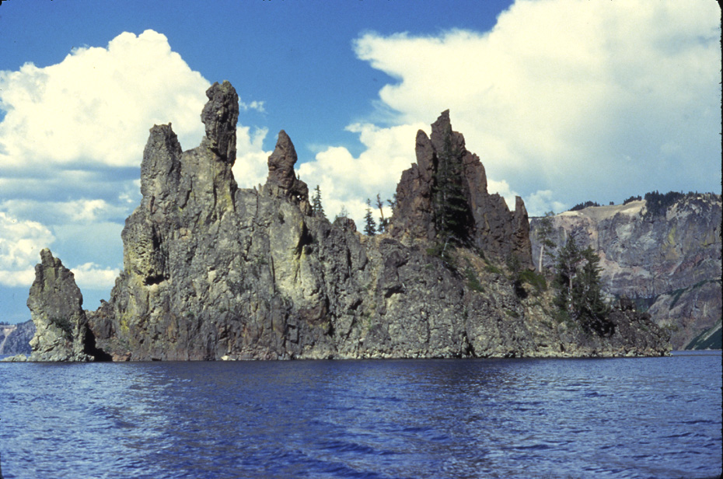
“Phantom Ship” (andesite flow)
Notes:
…. oldest andesite flows.

Slide 18
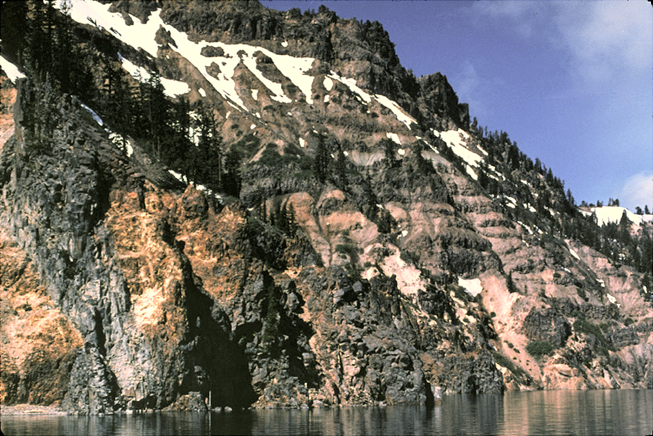
Caldera wall showing lava, cinders, and pumice layers
Notes:
As is characteristic of composite volcanoes, flows are interbedded with layers of various pyroclastics.

Slide 19
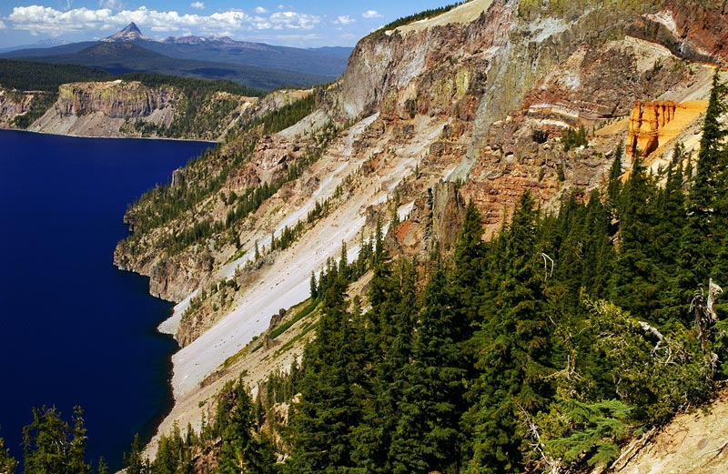
Pumice Castle
Notes:
“Pumice Castle” is a 70,000 year old remnant of one of Mount Mazama’s many pyroclastic eruptions that was exposed by the formation of the caldera ….

Slide 20
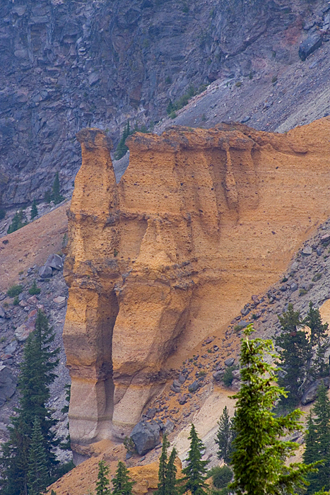
Notes:
… and sculpted by differential erosion.

Slide 21
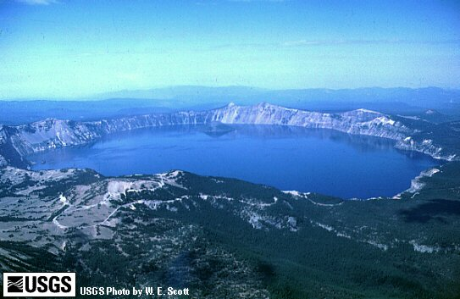
Mount Mazama prior to collapse
1500 m
9 km
Notes:
By projecting the slopes surrounding Crater Lake upward you can get an idea as to how big Mount Mazama was. At one time it probably had an elevation of about 12,000 feet and was the highest mountain in Oregon.

Slide 22
Crater Lake History
Built on older shield volcano
Growth of Mt. Mazama composite volcano
Glacial erosion (concurrent with volcanism)
Explosion craters fill with domes
Massive eruption of Mt. Mazama and subsequent caldera formation
Resurgent volcanism in caldera
Notes:
Such a tall mountain would surely have been glaciated, especially since it reached its maximum height during the later part of the Pleistocene glacial ages.

Slide 23
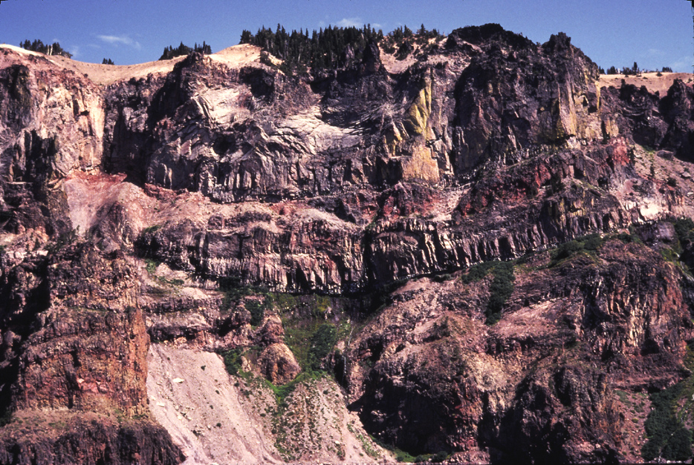
Glacial valley filled by lava flow
Base of glacial trough
Notes:
Since glacial erosion was concurrent with the growth of Mount Mazama, most of the U-shaped glacial troughs were filled with lava flows and pyroclastics.

Slide 24
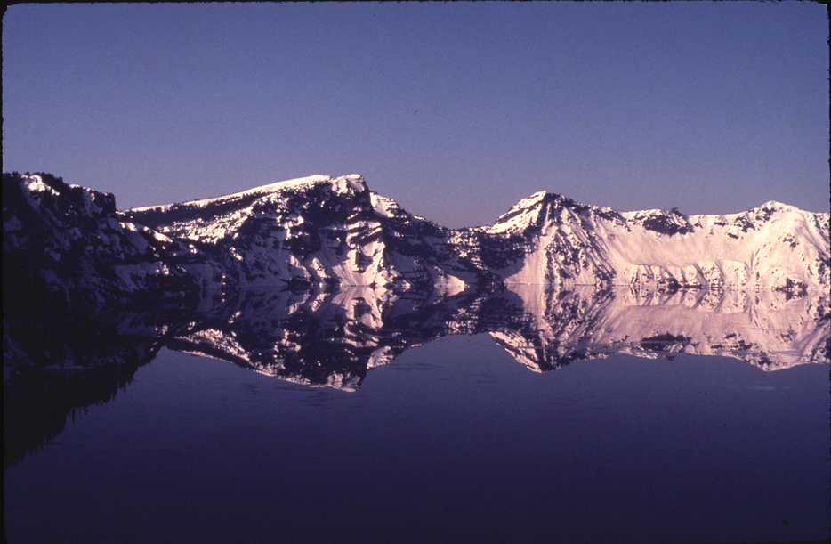
Kerr Notch
Sun Notch
Notes:
Others, such as Kerr Notch and Sun Notch, were not and now appear as broad U-shaped notches in the caldera’s rim.

Slide 25
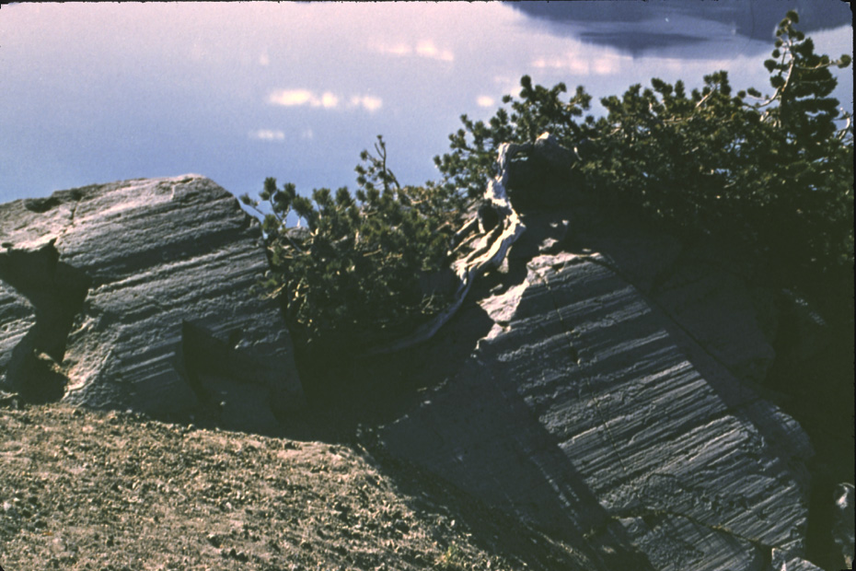
Glacial Striations
Notes:
Evidence of glacial erosion is also seen in these glacial striations.

